Slide 1
CUDA Based Fast and Accurate Image Feature Matching for Large Scale Dataset
Presented by
Xiang Deng, dxiang@seas.upenn.edu
12/15/2016

Slide 2
Background
Image matching is one of the most crucial stage in object recognition/classification, 3D reconstruction, motion estimation and image indexing.
For this project, we typically focusing on fast and accurate Image Matching for 3D reconstruction.
A typical application: To achieve fast and reliable indoor/outdoor localization and navigation, one cannot rely on sensors that is constrained by lighting conditions and range limitations.
Without a GPS, using only RGB cameras, the Structure from Motion (SfM) will still allow one recover the three-dimensional structural information based on the correspondences between two dimensional images.

Slide 3
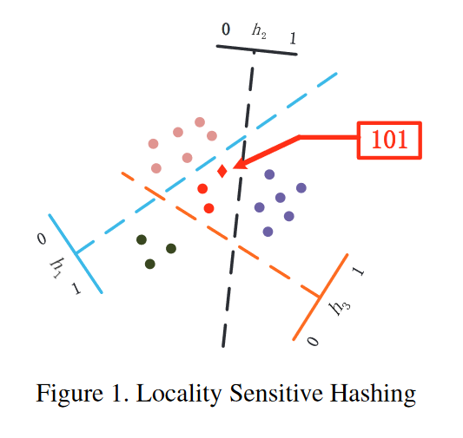
Algorithm Overview
Image Matching Pipeline [1]
Idea:
1. the projection of similar features will still look similar
2. increased number of random projections: increase probability of finding true matches in the projected location
Four stages:
Multi table (L tables) Hashing (feature descriptors (eg. SIFT (128 integers) →binary hash codes (128 bits * L) )
Candidates Look-up &Fetching O(L)
Candidates ranking O(k : number of candidates) in Hamming space
Final validation in Euclidean space
Source from [1], http://www.cv-foundation.org/openaccess/content_cvpr_2014/papers/Cheng_Fast_and_Accurate_2014_CVPR_paper.pdf

Slide 4
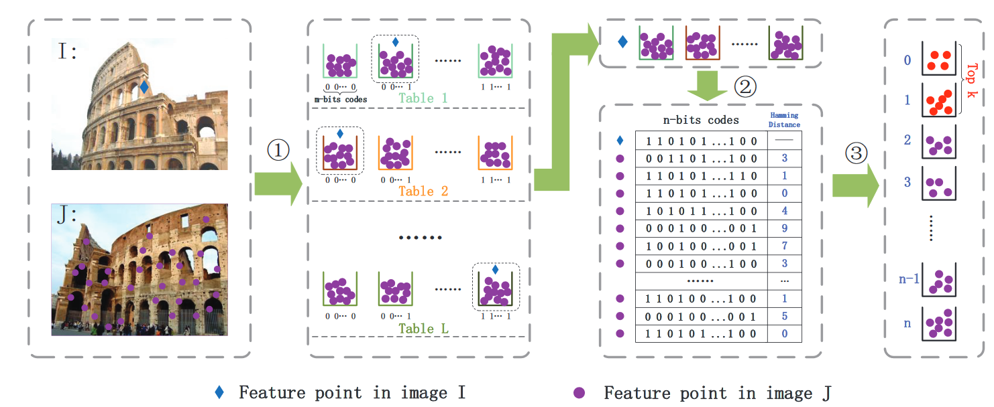
Algorithm Overview
Image Matching Pipeline [1]
Source from [1], http://www.cv-foundation.org/openaccess/content_cvpr_2014/papers/Cheng_Fast_and_Accurate_2014_CVPR_paper.pdf

Slide 5
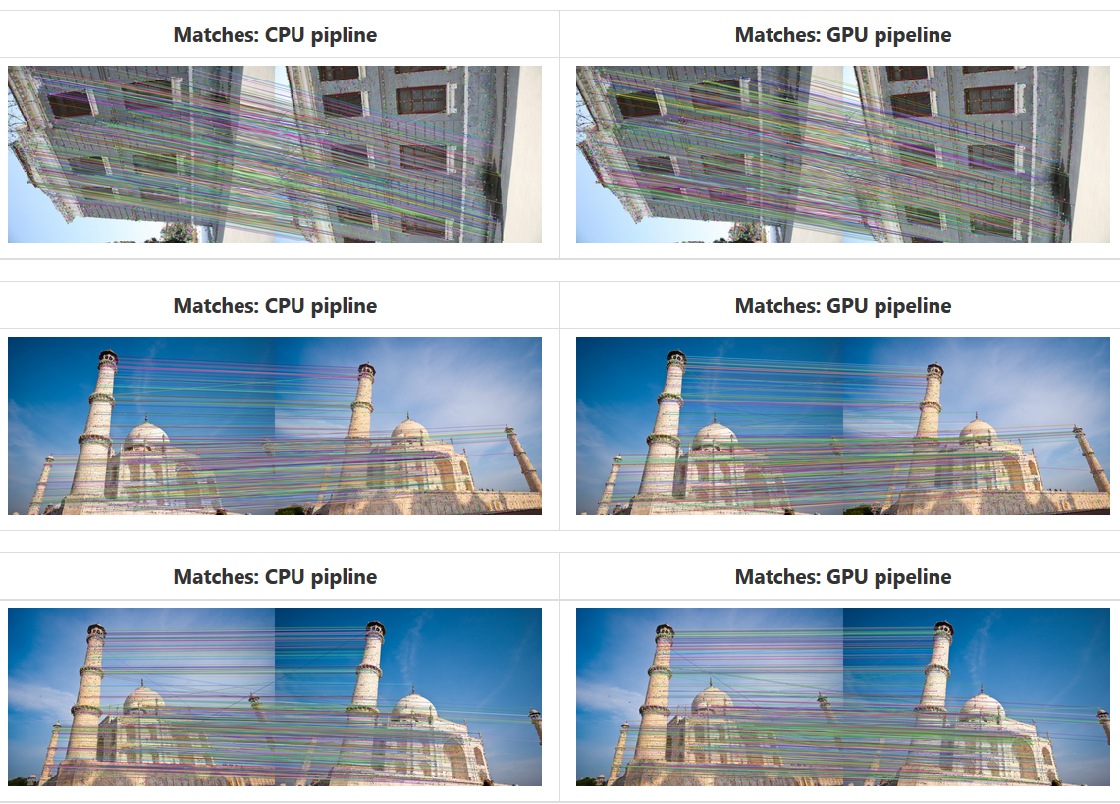
Visualizations

Slide 6
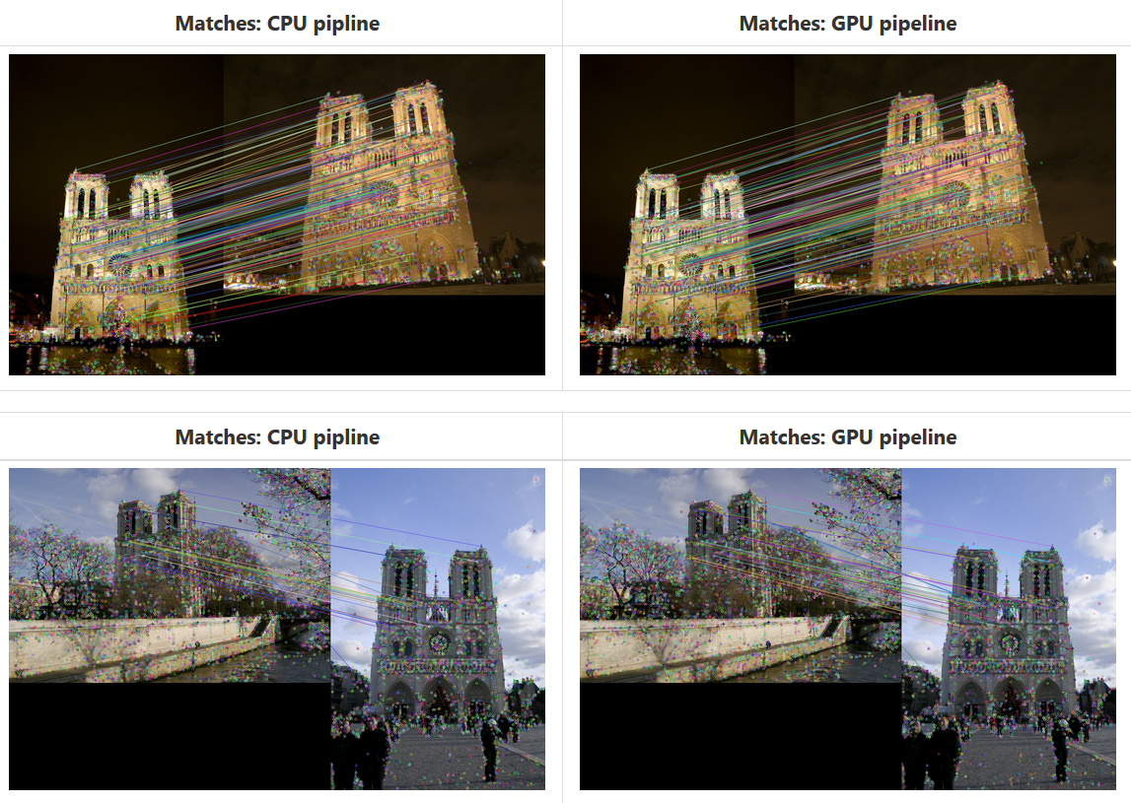
Visualizations

Slide 7
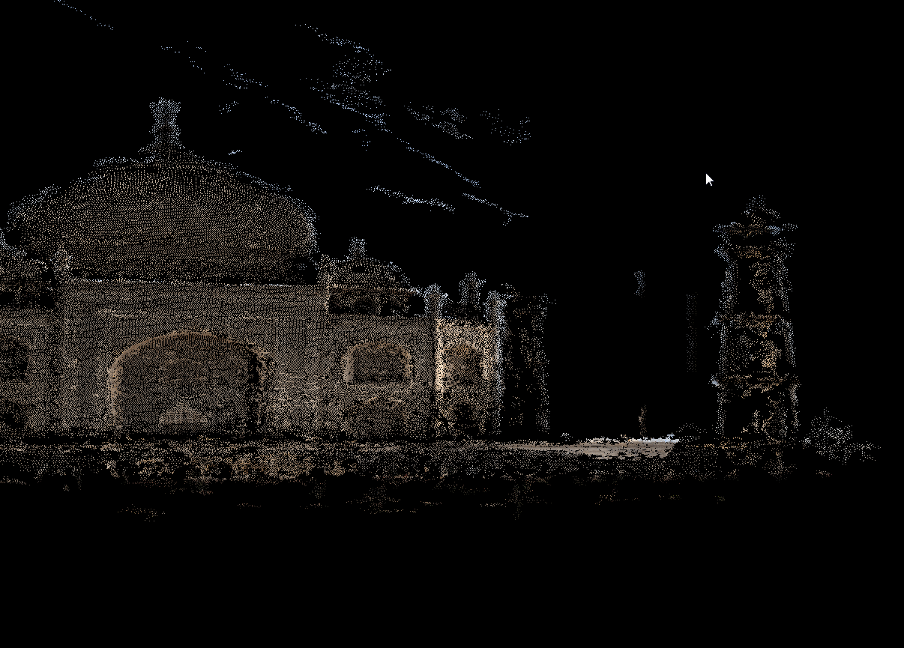
Better reconstruction results on larger scale dataset

Slide 8
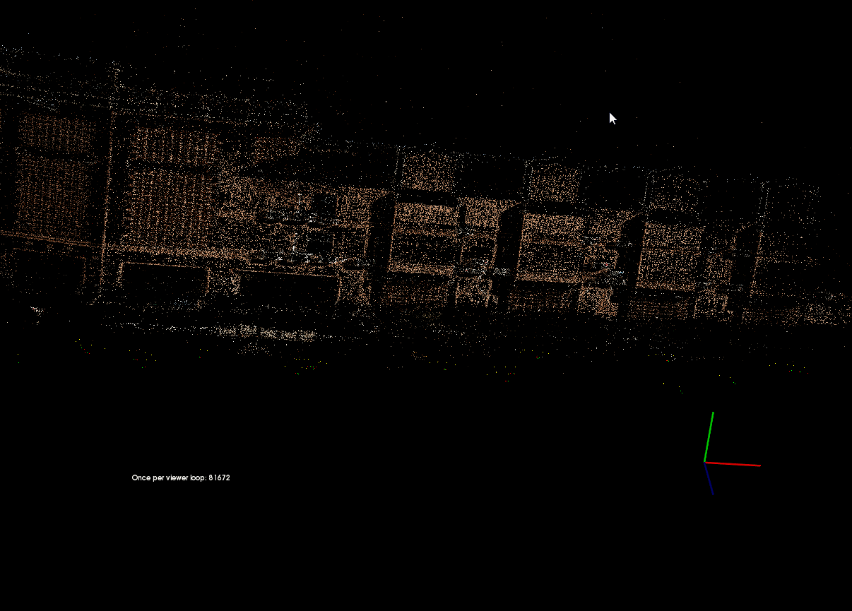
Better reconstruction results on larger scale dataset

Slide 9
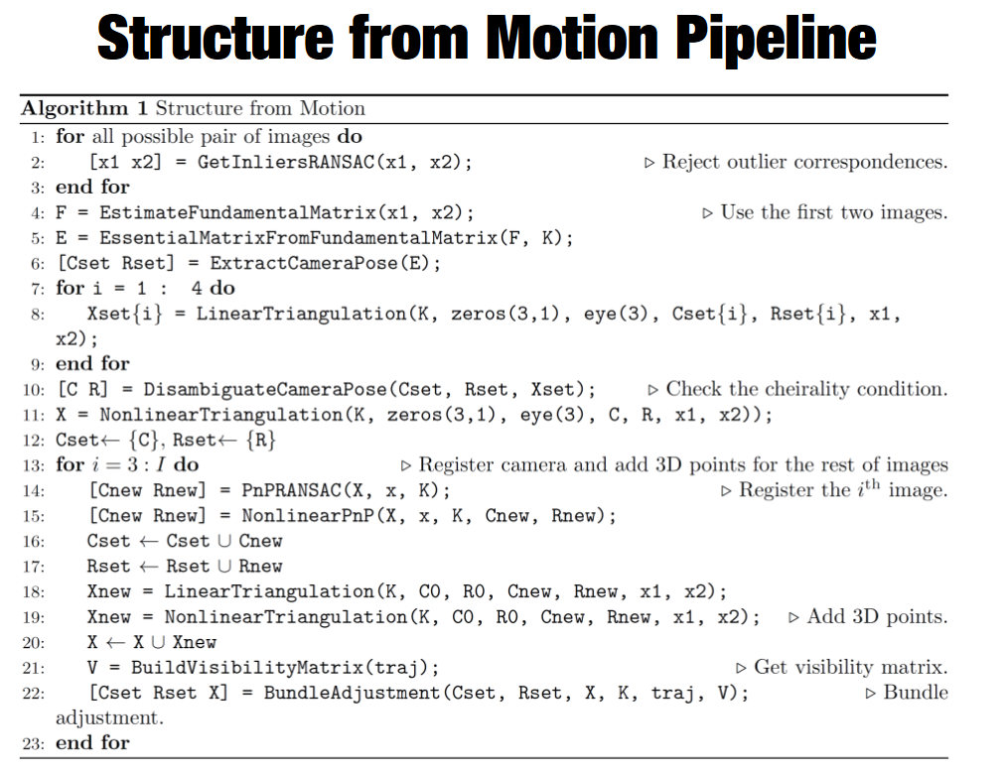
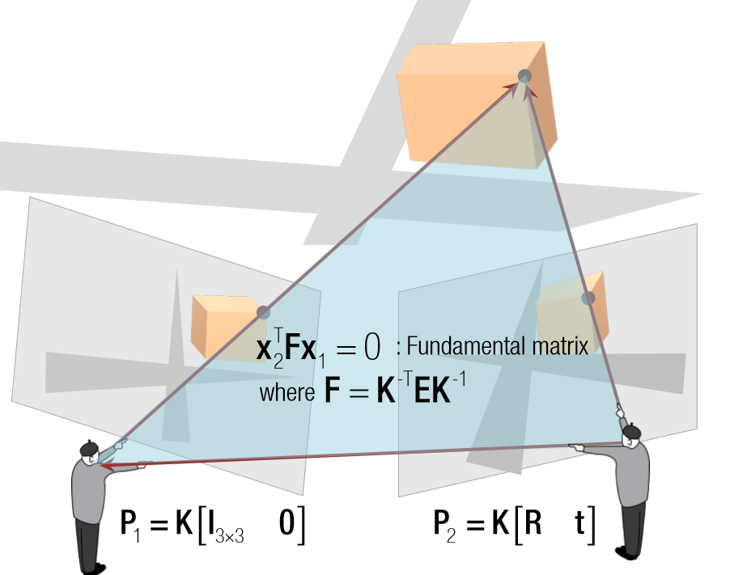
Algorithm Overview (supplementary slides)
Pointers to Structure from Motion pipeline
Here are the slides from Prof. Jianbo Shi http://cis.upenn.edu/~cis580/Spring2016/Lectures/cis580-18-coursera-2016-SfM-fulll.pdf
However, suppose the 3D scene is already reconstructed (or given), for localization, we would only need line 1 to line 10.

Slide 10
CUDA implementations (optimizations)
Global shared buffers for data storage
Shared buffers → goal: O(1) look up
Dynamic memory allocation is inefficient
N(~1000 -1000) to 1 access
Hierarchy: Three layers of buffers:
Two buffers for features, hash code and sift
One for counters (for access to memory)
One for hash code indexing
Inter dependency, but allows O(1) complexity for lookup
Hard part: actually using multiple hash tables for accuracy
Mean shift of features
i.e. Subtract by the mean values
Sift to hash codes: naïve projection O(KL)
Sift feature descriptor → buffers
Build bucket list & bucket id list (lookup table)→ key for efficiency

Slide 11
CUDA implementations (optimizations)
Quantized linked list
Motivation: want to avoid sorting (of candidates) during the matching stage, too expensive for each kernels
Each thread is accompanied by linked list buffers
Linked lists are indexed by hamming distances (0-127)-> automatic sorting

Slide 12
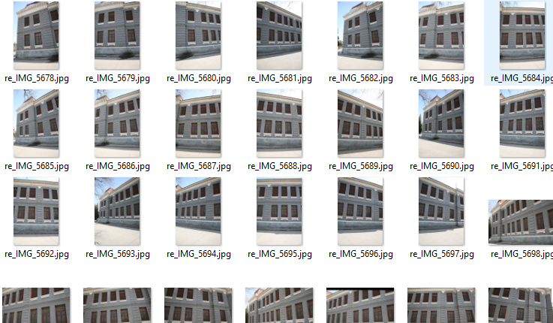
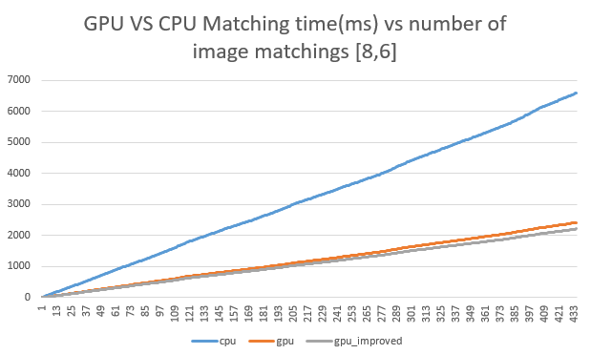
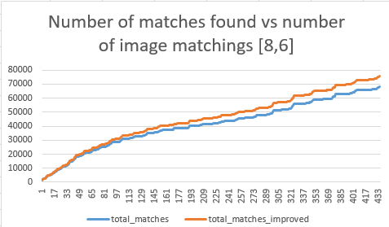
Performance
Number of bits of hash code→ sparsity in hash table
Testing: 8,10,12 bits

Slide 13
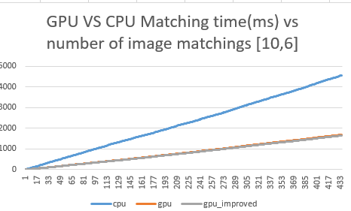
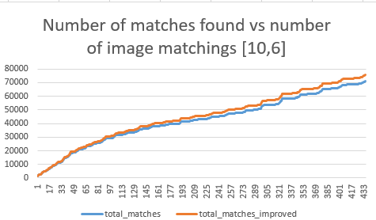
Performance
Number of bits of hash code→ sparsity in hash table
Testing: 8,10,12 bits

Slide 14
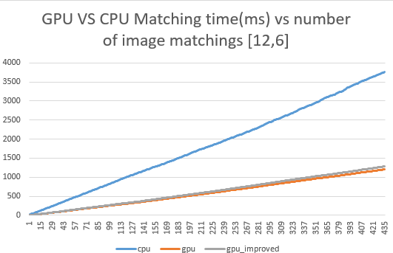
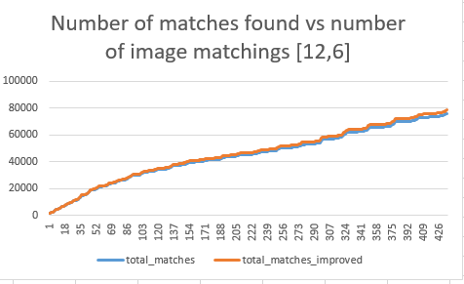
Performance
Number of bits of hash code→ sparsity in hash table
Testing: 8,10,12 bits

Slide 15
Performance
Number of bits of hash code<->sparsity in hash table
Testing: 8,10,12 bits

Slide 16
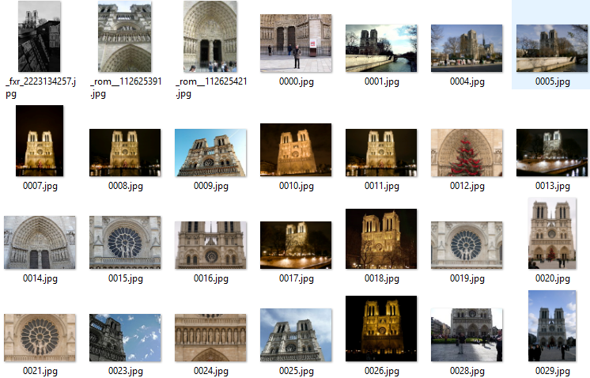
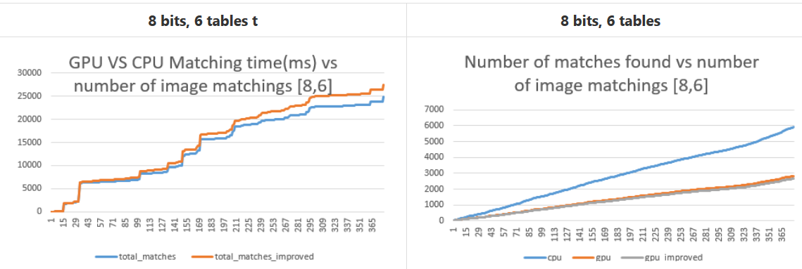
Performance
Number of bits of hash code→ sparsity in hash table
Testing: 8,10,12 bits

Slide 17
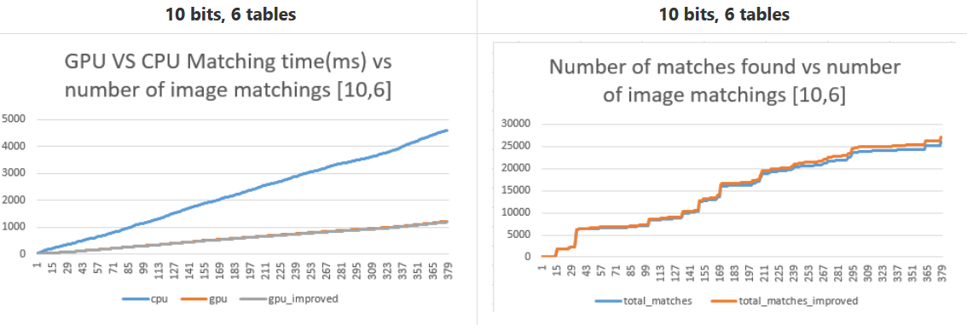
Performance
Number of bits of hash code→ sparsity in hash table
Testing: 8,10,12 bits

Slide 18
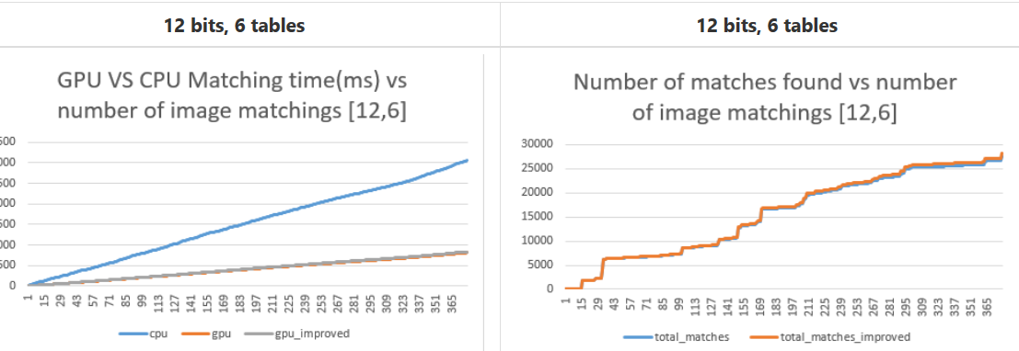
Performance
Number of bits of hash code→ sparsity in hash table
Testing: 8,10,12 bits

Slide 19
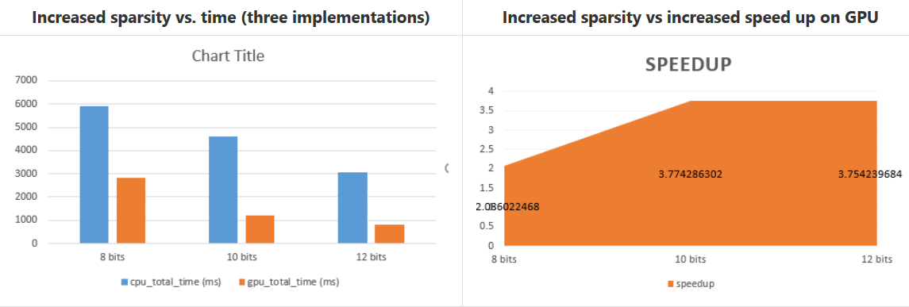
Performance
Number of bits of hash code<->sparsity in hash table
Testing: 8,10,12 bits (why saturates?->)

Slide 20
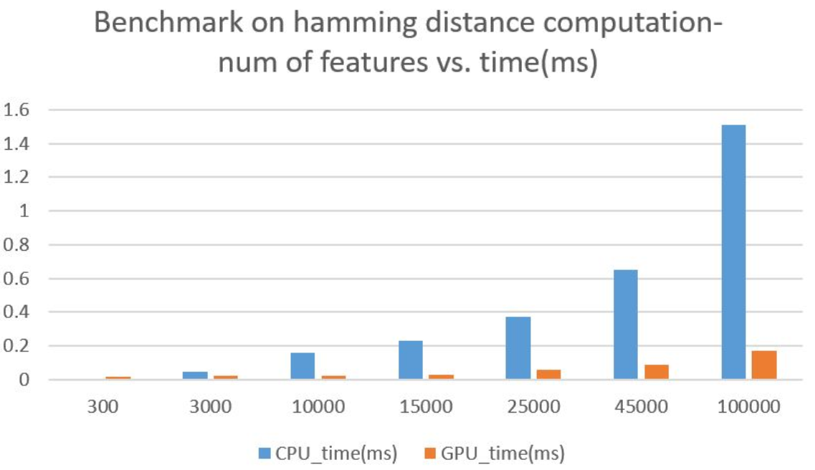
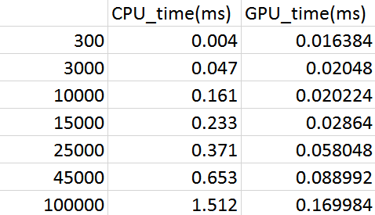
Drawbacks
In comparison to pure hamming distance computation
Possible reasons for reduced speedup:
Memory access (complex datastrucre of pointers)
Validation in Euclidean space (norm of 128 integers vs hash code distance: only one cycle)

Slide 21
Drawbacks
Quantized linked list:
Memory usage: each buffer size: 163840 bytes, pre-allocated 12000-20000 buffers (one buffer per feature matching)
In total: 1966-~4000MB
A probable better idea: one buffer per *active* thread

Slide 22
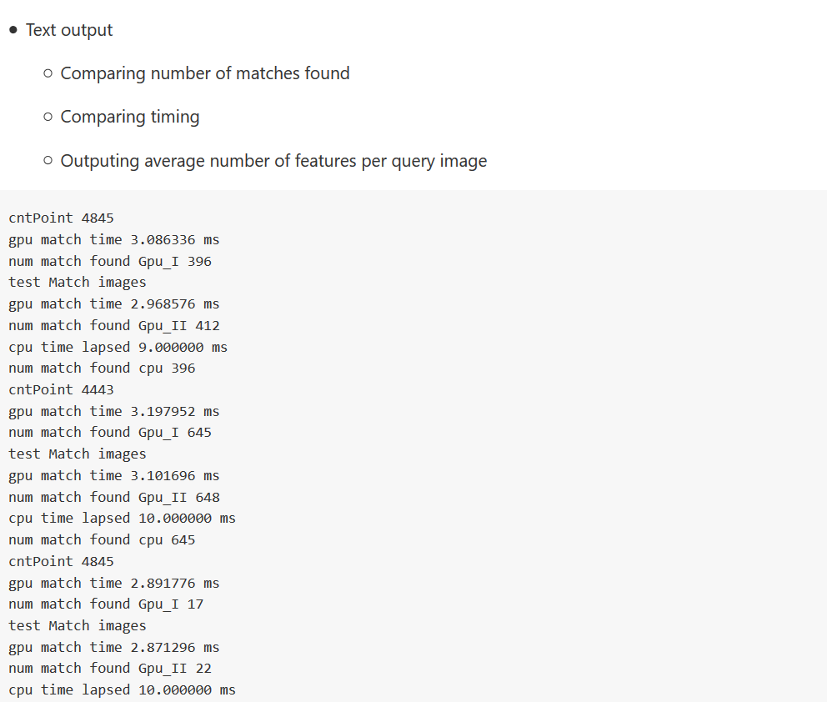
More Debugging Views

Slide 23
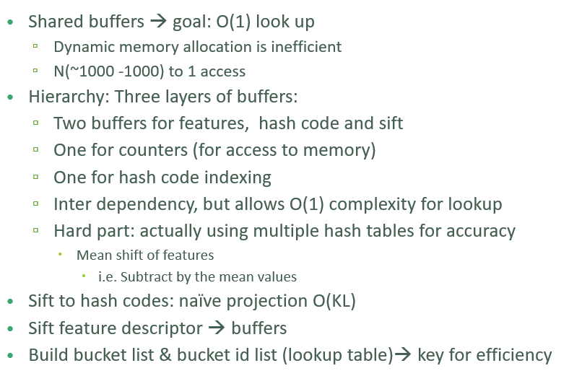
Performance

Slide 24
Questions
References
J. Cheng, C. Leng, J. Wu and H. Lu, "Fast and accurate image matching with cascade hashing for 3d reconstruction.," in IEEE Conference on Computer Vision and Pattern Recognition (CVPR2014), 2014.
SfM slides, http://cis.upenn.edu/~cis580/Spring2016/Lectures/cis580-18-coursera-2016-SfM-fulll.pdf
Dataset used for sample result, http://vision.ia.ac.cn/data/index.html
Flickr Dataset

